Slide 1
Azure Blob Storage
Azure Blob Storage is a service that stores unstructured data in the cloud as objects or blobs. Blob stands for Binary Large Object. Blob Storage is also referred to as object storage or container storage.
Things to know about Azure Blob Storage
Blob Storage can store any type of text or binary data. Some examples are text documents, images, video files, and application installers.
Blob Storage uses three resources to store and manage your data:
An Azure storage account
Containers in an Azure storage account
Blobs in a container
To implement Blob Storage, you configure several settings:
Blob container options
Blob types and upload options
Blob Storage access tiers
Blob lifecycle rules
Blob object replication options

Slide 2
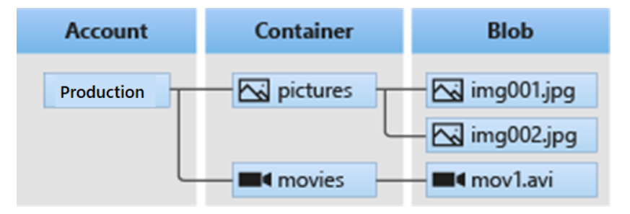
The following diagram shows the relationship between the Blob Storage resources.
Things to consider when implementing Azure Blob Storage
There are many common uses for Blob Storage. Consider the following scenarios and think about your own data needs:
Consider browser uploads. Use Blob Storage to serve images or documents directly to a browser.
Consider distributed access. Blob Storage can store files for distributed access, such as during an installation process.
Consider streaming data. Stream video and audio by using Blob Storage.
Consider archiving and recovery. Blob Storage is a great solution for storing data for backup and restore, disaster recovery, and archiving.
Consider application access. You can store data in Blob Storage for analysis by an on-premises or Azure-hosted service.

Slide 3
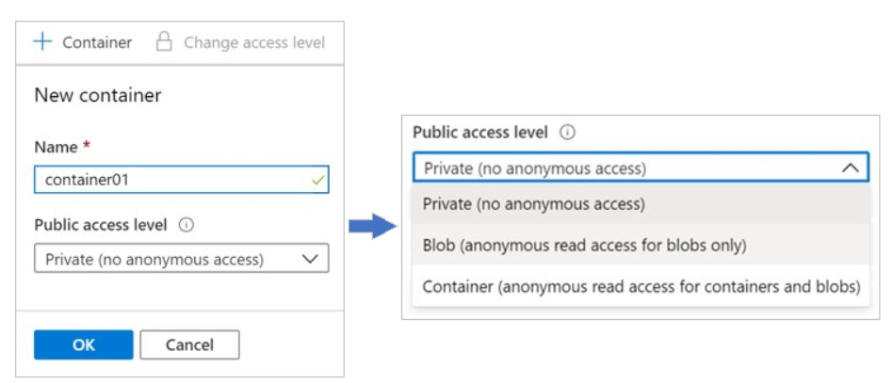
Create blob containers
Azure Blob Storage uses a container resource to group a set of blobs. A blob can't exist by itself in Blob Storage. A blob must be stored in a container resource.
Things to know about containers and blobs
Let's look at the configuration characteristics of containers and blobs.
All blobs must be in a container.
A container can store an unlimited number of blobs.
An Azure storage account can contain an unlimited number of containers.
You can create the container in the Azure portal.
You upload blobs into a container.
Configure a container

Slide 4
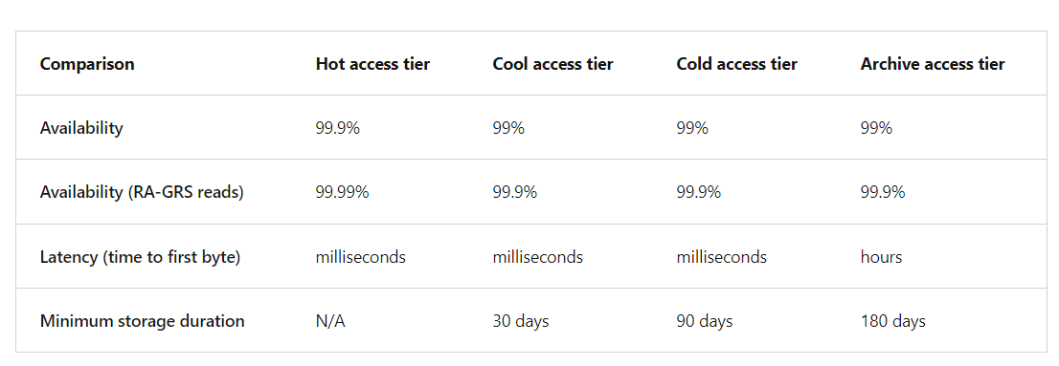
Name: Enter a name for your container. The name must be unique within the Azure storage account.
The name can contain only lowercase letters, numbers, and hyphens.
The name must begin with a letter or a number.
The minimum length for the name is three characters.
The maximum length for the name is 63 characters.
Public access level: The access level specifies whether the container and its blobs can be accessed publicly. By default, container data is private and visible only to the account owner. There are three access level choices:
Private: (Default) Prohibit anonymous access to the container and blobs.
Blob: Allow anonymous public read access for the blobs only.
Container: Allow anonymous public read and list access to the entire container, including the blobs.

Slide 5
Hot tier
The Hot tier is optimized for frequent reads and writes of objects in the Azure storage account. A good usage case is data that is actively being processed. By default, new storage accounts are created in the Hot tier. This tier has the lowest access costs, but higher storage costs than the Cool and Archive tiers.
Cool tier
The Cool tier is optimized for storing large amounts of data that's infrequently accessed. This tier is intended for data that remains in the Cool tier for at least 30 days. A usage case for the Cool tier is short-term backup and disaster recovery datasets and older media content. This content shouldn't be viewed frequently, but it needs to be immediately available. Storing data in the Cool tier is more cost-effective. Accessing data in the Cool tier can be more expensive than accessing data in the Hot tier.
Cold tier
The Cold tier is also optimized for storing large amounts of data that's infrequently accessed. This tier is intended for data that can remain in the tier for at least 90 days.
Archive tier
The Archive tier is an offline tier that's optimized for data that can tolerate several hours of retrieval latency. Data must remain in the Archive tier for at least 180 days or be subject to an early deletion charge. Data for the Archive tier includes secondary backups, original raw data, and legally required compliance information. This tier is the most cost-effective option for storing data. Accessing data is more expensive in the Archive tier than accessing data in the other tiers.

Slide 6
Add blob lifecycle management rules
Every data set has a unique lifecycle. Early in the lifecycle, users tend to access some of the data in the set, but not all of the data. As the data set ages, access to all of the data in the set tends to dramatically reduce. Some data set stays idle in the cloud and is rarely accessed after it's stored. Some data expires within a few days or months after it's created. Other data is actively read and modified throughout the data set lifetime.
Azure Blob Storage supports lifecycle management for data sets. It offers a rich rule-based policy for GPv2 and Blob Storage accounts. You can use lifecycle policy rules to transition your data to the appropriate access tiers, and set expiration times for the end of a data set's lifecycle.
Things to know about lifecycle management
You can use Azure Blob Storage lifecycle management policy rules to accomplish several tasks.
Transition blobs to a cooler storage tier (Hot to Cool, Hot to Archive, Cool to Archive) to optimize for performance and cost.
Delete blobs at the end of their lifecycles.
Define rule-based conditions to run once per day at the Azure storage account level.
Apply rule-based conditions to containers or a subset of blobs.

Slide 7
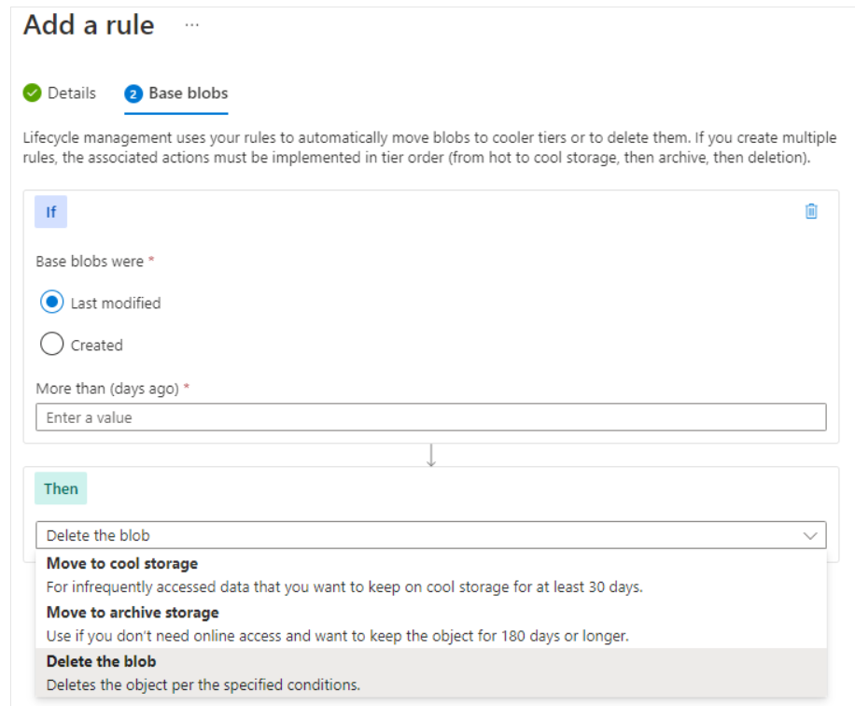
Business scenario
Consider a scenario where data is frequently accessed in the early stages of the lifecycle, but only occasionally after two weeks. After the first month, the data set is rarely accessed. In this scenario, the Hot tier of Blob Storage is best during the early stages. Cool tier storage is most appropriate for occasional access. Archive tier storage is the best option after the data ages over a month. To achieve this transition, lifecycle management policy rules are available to move aging data to cooler tiers.
Configure lifecycle management policy rules
In the Azure portal, you create lifecycle management policy rules for your Azure storage account by specifying several settings. For each rule, you create If - Then block conditions to transition or expire data based on your specifications. As you review these details, consider how you can set up lifecycle management policy rules for your data sets.

Slide 8
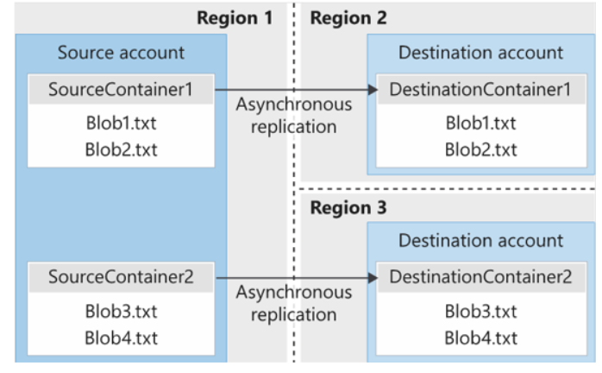
blob object replication
Object replication copies blobs in a container asynchronously according to policy rules that you configure. During the replication process, the following contents are copied from the source container to the destination container:
The blob contents
The blob metadata and properties
Any versions of data associated with the blob
The following illustration shows an example of asynchronous replication of blob containers between regions.
Things to consider when configuring blob object replication
There are many benefits to using blob object replication. Consider the following scenarios and think about how replication can be a part of your Blob Storage strategy.
Consider latency reductions. Minimize latency with blob object replication. You can reduce latency for read requests by enabling clients to consume data from a region that's in closer physical proximity.
Consider efficiency for compute workloads. Improve efficiency for compute workloads by using blob object replication. With object replication, compute workloads can process the same sets of blobs in different regions.
Consider data distribution. Optimize your configuration for data distribution. You can process or analyze data in a single location and then replicate only the results to other regions.
Consider costs benefits. Manage your configuration and optimize your storage policies to achieve cost benefits. After your data is replicated, you can reduce costs by moving the data to the Archive tier by using lifecycle management policies.

Slide 9
Things to know about blob object replication
There are several considerations to keep in mind when planning your configuration for blob object replication.
Object replication requires that blob versioning is enabled on both the source and destination accounts.
Object replication doesn't support blob snapshots. Any snapshots on a blob in the source account aren't replicated to the destination account.
Object replication is supported when the source and destination accounts are in the Hot, Cool, or Cold tier. The source and destination accounts can be in different tiers.
When you configure object replication, you create a replication policy that specifies the source Azure storage account and the destination storage account.
A replication policy includes one or more rules that specify a source container and a destination container. The policy identifies the blobs in the source container to replicate.
Things to know about blob types
Block blobs. A block blob consists of blocks of data that are assembled to make a blob. Most Blob Storage scenarios use block blobs. Block blobs are ideal for storing text and binary data in the cloud, like files, images, and videos.
Append blobs. An append blob is similar to a block blob because the append blob also consists of blocks of data. The blocks of data in an append blob are optimized for append operations. Append blobs are useful for logging scenarios, where the amount of data can increase as the logging operation continues.
Page blobs. A page blob can be up to 8 TB in size. Page blobs are more efficient for frequent read/write operations. Azure Virtual Machines uses page blobs for operating system disks and data disks.
The block blob type is the default type for a new blob. When you're creating a new blob, if you don't choose a specific type, the new blob is created as a block blob.
After you create a blob, you can't change its type.

Slide 10
Blob Storage pricing
All Azure storage accounts use a pricing model for Azure Blob Storage that's based on the tier of each blob.
Things to know about pricing for Blob Storage
Review the following billing considerations for an Azure storage account and Blob Storage.
Performance tiers. The Blob Storage tier determines the amount of data stored and the cost for storing that data. As the performance tier gets cooler, the per-gigabyte cost decreases.
Data access costs. Data access charges increase as the tier gets cooler. For data in the Cool and Archive tiers, you're billed a per-gigabyte data access charge for reads.
Transaction costs. There's a per-transaction charge for all tiers. The charge increases as the tier gets cooler.
Geo-replication data transfer costs. This charge only applies to accounts that have geo-replication configured, including GRS and RA-GRS. Geo-replication data transfer incurs a per-gigabyte charge.
Outbound data transfer costs. Outbound data transfers (data that's transferred out of an Azure region) incur billing for bandwidth usage on a per-gigabyte basis. This billing is consistent with general-purpose Azure storage accounts.
Changes to the storage tier. If you change the account storage tier from Cool to Hot, you incur a charge equal to reading all the data existing in the storage account. Changing the account storage tier from Hot to Cool incurs a charge equal to writing all the data into the Cool tier (GPv2 accounts only).

Slide 11
Compare storage for file shares and blob data
Azure Files offers shared storage for applications by using the industry standard Server Message Block and Network File System (NFS) protocols. Azure virtual machines (VMs) and cloud services can share file data across application components by using mounted shares. On-premises applications can also access file data in the share.
Things to know about Azure Files
Let's examine some characteristics of Azure Files.
Azure Files stores data as true directory objects in file shares.
Azure Files provides shared access to files across multiple VMs. Any number of Azure virtual machines or roles can mount and access an Azure file share simultaneously.
Applications that run in Azure VMs or cloud services can mount an Azure file share to access file data. This process is similar to how a desktop application mounts a typical SMB share.
Azure Files offers fully managed file shares in the cloud. Azure file shares can be mounted concurrently by cloud or on-premises deployments of Windows, Linux, and macOS.

Slide 12
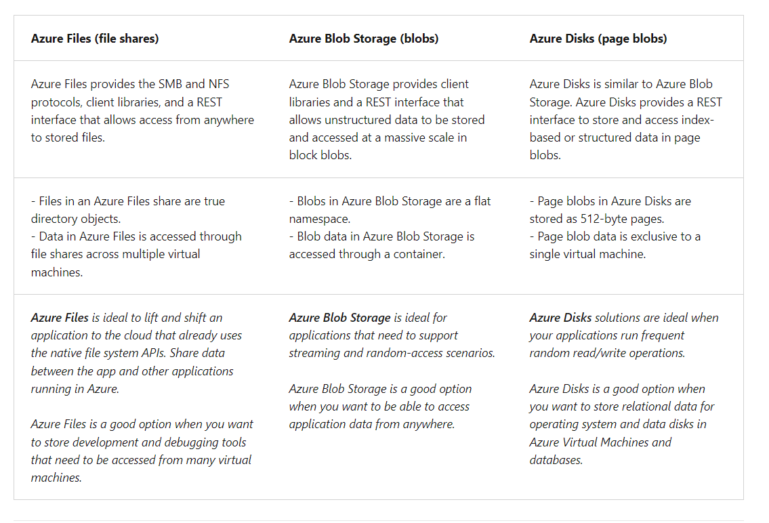

Slide 13
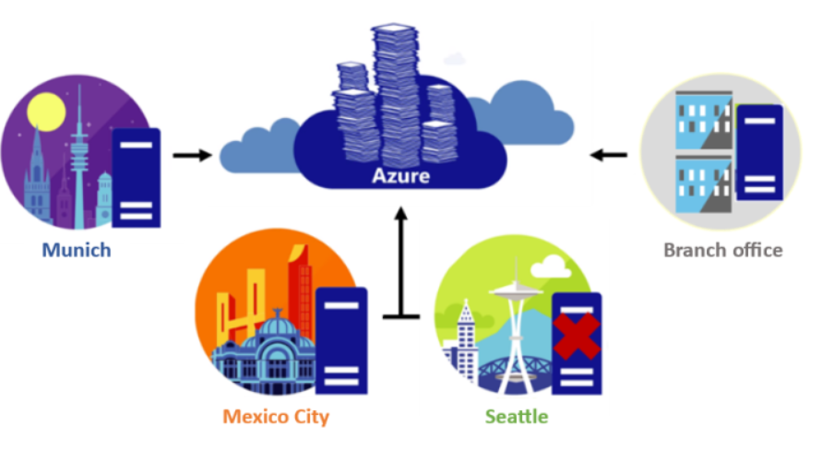
Azure File Sync
Azure File Sync enables you to cache several Azure Files shares on an on-premises Windows Server or cloud virtual machine. You can use Azure File Sync to centralize your organization's file shares in Azure Files, while keeping the flexibility, performance, and compatibility of an on-premises file server.
Things to know about Azure File Sync
Let's take a look at the characteristics of Azure File Sync.
Azure File Sync transforms Windows Server into a quick cache of your Azure Files shares.
You can use any protocol that's available on Windows Server to access your data locally with Azure File Sync, including SMB, NFS, and FTPS.
Azure File Sync supports as many caches as you need around the world.

Slide 14
Cloud tiering
Cloud tiering is an optional feature of Azure File Sync. Frequently accessed files are cached locally on the server while all other files are tiered to Azure Files based on policy settings.
When a file is tiered, Azure File Sync replaces the file locally with a pointer. A pointer is commonly referred to as a reparse point. The reparse point represents a URL to the file in Azure Files.
When a user opens a tiered file, Azure File Sync seamlessly recalls the file data from Azure Files without the user needing to know that the file is stored in Azure.
Things to consider when using Azure File Sync
There are many advantages to using Azure File Sync. Consider the following scenarios, and think about how you can use Azure File Sync with your Azure Files shares.
Consider application lift and shift. Use Azure File Sync to move applications that require access between Azure and on-premises systems. Provide write access to the same data across Windows Servers and Azure Files.
Consider support for branch offices. Support your branch offices that need to back up files by using Azure File Sync. Use the service to set up a new server that connects to Azure storage.
Consider backup and disaster recovery. After you implement Azure File Sync, Azure Backup backs up your on-premises data. Restore file metadata immediately and recall data as needed for rapid disaster recovery.
Consider file archiving with cloud tiering. Azure File Sync stores only recently accessed data on local servers. Implement cloud tiering so non-used data moves to Azure Files.

Slide 15
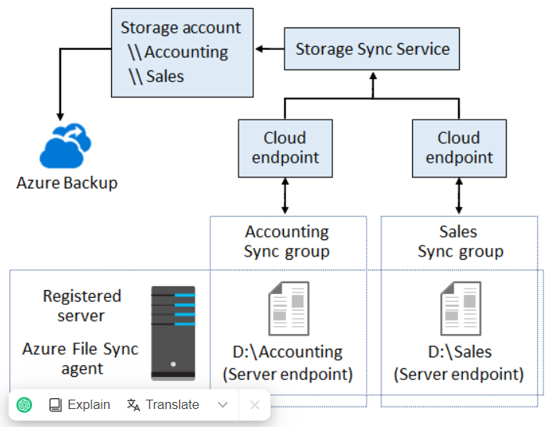
Azure File Sync components
Azure File Sync is composed of four main components that work together to provide caching for Azure Files shares on an on-premises Windows Server or cloud virtual machine.
Storage Sync Service
The Storage Sync Service is the top-level Azure resource for Azure File Sync. This resource is a peer of the storage account resource and can be deployed in a similar manner.
The Storage Sync Service forms sync relationships with multiple storage accounts by using multiple sync groups.
The service requires a distinct top-level resource from the storage account resource to support the sync relationships.
A subscription can have multiple Storage Sync Service resources deployed.

Slide 16
Sync group
A sync group defines the sync topology for a set of files. Endpoints within a sync group are kept in sync with each other. Consider the scenario where you have two distinct sets of files that you want to manage with Azure File Sync. In this case, you create two sync groups and add different endpoints to each sync group. An instance of the Storage Sync Service can host as many sync groups as you need.
Registered server
The registered server object represents a trust relationship between your server (or cluster) and the Storage Sync Service resource. You can register as many servers to a Storage Sync Service resource as you want.
Azure File Sync agent
The Azure File Sync agent is a downloadable package that enables Windows Server to be synced with an Azure file share. The Azure File Sync agent has three main components:
FileSyncSvc.exe: This file is the background Windows service that's responsible for monitoring changes on server endpoints, and for initiating sync sessions to Azure.
StorageSync.sys: This file is the Azure File Sync file system filter that supports cloud tiering. The filter is responsible for tiering files to Azure Files when cloud tiering is enabled.
PowerShell cmdlets: These PowerShell management cmdlets allow you to interact with the Microsoft.StorageSync Azure resource provider. You can find the cmdlets at the following (default) locations:
C:\\Program Files\\Azure\\StorageSyncAgent\\StorageSync.Management.PowerShell.Cmdlets.dll
C:\\Program Files\\Azure\\StorageSyncAgent\\StorageSync.Management.ServerCmdlets.dll

Slide 17
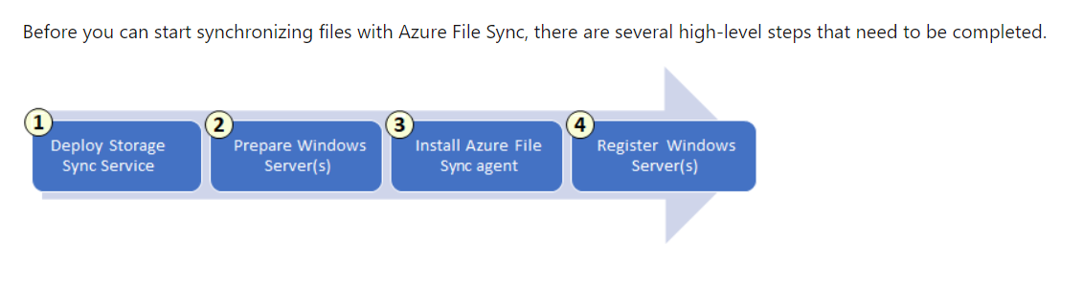
Server endpoint
A server endpoint represents a specific location on a registered server, such as a folder on a server volume. Multiple server endpoints can exist on the same volume if their namespaces are unique (for example, F:\\sync1 and F:\\sync2).
Cloud endpoint
A cloud endpoint is an Azure file share that's part of a sync group. As part of a sync group, the entire cloud endpoint (Azure file share) syncs.
An Azure file share can be a member of one cloud endpoint only.
An Azure file share can be a member of one sync group only.
Consider the scenario where you have a share with existing files. If you add the share as a cloud endpoint to a sync group, the files in the share are merged with files on other endpoints in the sync group.
Deploy Azure File Sync

Slide 18
Step 1: Deploy the Storage Sync Service
You can deploy the Storage Sync Service from the Azure portal. You configure the following settings:
The deployment name for the Storage Sync Service
The Azure subscription ID to use for the deployment
A Resource Group for the deployment
The deployment location
Step 2: Prepare each Windows Server to use Azure File Sync
After you deploy the Storage Sync Service, you configure each Windows Server or cloud virtual machine that you intend to use with Azure File Sync, including server nodes in a Failover Cluster.
Step 3: Install the Azure File Sync agent
When the Windows Server configuration is complete, you're ready to install the Azure File Sync agent. The agent is a downloadable package that enables Windows Server to be synced with an Azure Files share. The Azure File Sync agent installation package should install relatively quickly.
Step 4: Register each Windows Server with the Storage Sync Service
After the Azure File Sync agent installation completes, the Server Registration window opens.
By registering the Windows Server with a Storage Sync Service, you establish a trust relationship between your server (or cluster) and the Storage Sync Service. For the registration, you need your Azure subscription ID and some of the deployment settings you configured in the first step:
The Storage Sync Service deployment name
The Resource Group for the deployment

Slide 19
Demonstration
https://microsoftlearning.github.io/AZ-104-MicrosoftAzureAdministrator/Instructions/Demos/07%20-%20Administer%20Azure%20Storage.html
LAB
https://microsoftlearning.github.io/AZ-104-MicrosoftAzureAdministrator/Instructions/Labs/LAB_07-Manage_Azure_Storage.html

